Slide 1

Covid-19 vaccine Analysis
and
Prediction
Project By: Shikha Kumari
Guide by: Ms.Arpita Roy

Slide 2
S.no | Contence
T | Problem Statement
2. | Project Over View
3 | Why We need this?
4 | How it will help people?
5 | Solution
6 | How it’s unique
7 | Modelling(Analysis Model)And Visualization
8 | Live Demo-Analysis Dashboard
9 | Result(Prediction Model)

Slide 3
Problem Statement
This concise problem statement highlights the key challenge of ensuring the efficient and fair distribution of COVID-19 vaccines.

Slide 4
Project overview
Our project aims to ensure effective distribution, accessibility, and public trust in COVID-19 vaccines, facilitating widespread vaccination and pandemic control.

Slide 5
Why we need this?
Developing an Effective COVID-19 Vaccine: Addressing Urgent Global Needs
In the midst of a relentless pandemic, the urgent need for a COVID-19 vaccine cannot be overstated. Our project aims to contribute to this crucial endeavor by conducting research, clinical trials, and collaborations with pharmaceutical partners. A successful vaccine not only saves lives but also provides a pathway to global recovery, restoring normalcy to societies, economies, and healthcare systems worldwide. By investing in this initiative, we can mitigate the devastating impact of the virus, protect vulnerable populations, and pave the way for a safer and healthier future for everyone.

Slide 6
How it will help people
Accelerating COVID-19 Vaccination: A Lifesaving Initiative
Our project is dedicated to rapidly and efficiently distributing COVID-19 vaccines to the global population. By ensuring widespread vaccination, we aim to curb the spread of the virus, reduce hospitalizations, and save lives. Through strategic outreach and education, we empower communities to make informed decisions about vaccination, fostering immunity and safeguarding public health. Ultimately, our efforts contribute to creating safer environments, restoring normalcy, and offering hope for a healthier future for people around the world.

Slide 7
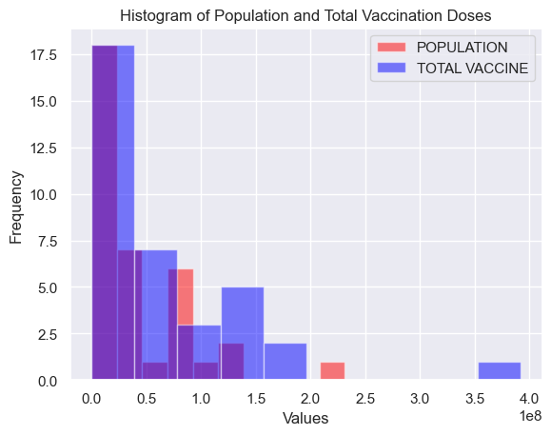
Our Solution To Analyze and Predict The Doses Of Vaccine

Slide 8
What makes your concept unique?
Revolutionizing COVID-19 Vaccination: Our Unique Approach
What sets our project apart is its innovative blend of cutting-edge technology, data-driven strategies, and community-centric focus. We leverage advanced algorithms to optimize vaccine distribution, ensuring every dose reaches its intended recipient promptly. Our emphasis on community engagement involves tailored awareness campaigns, addressing specific concerns and building trust. Additionally, real-time monitoring enables us to adapt swiftly, ensuring efficient utilization of resources. This holistic approach, combining technology, community involvement, and adaptability, forms the backbone of our unique and effective COVID-19 vaccination initiative.

Slide 9
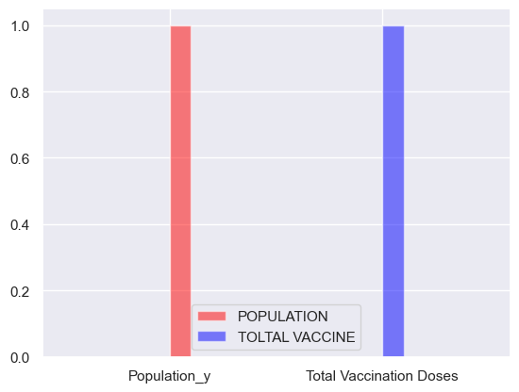
Modelling (Analysis Model) And Visualization
<matplotlib.legend.Legend at 0x250d7caa050>

Slide 11

Credit Goes to:
Mentor : Ms.Arpita Roy

